Slide 1
Queensland Emergency Risk Management Framework (QERMF)
Hazard and Risk Unit
Queensland Fire and Emergency Services

Slide 2
Presentation Scope
Introduction: Queensland Emergency Risk Management Framework (QERMF)
The Risk Assessment Process
Changing the Understanding of Hazards
Geospatial Intelligence
Management of Residual Risk
State Based Assessments – Supporting Local Disaster Management Planning
Outputs of the QERMF – What does this mean for you?

Slide 3
Queensland Emergency Risk Management Framework (QERMF)
The Queensland Emergency Risk Management Framework (QERMF) was developed in 2015 as a response to a request from Department of Premier and Cabinet to QFES to develop a State Risk Register.
Trialled as a proof of concept in 2016, it is underpinned by a multidisciplinary approach, including contemporary international and Australasian risk management practices, and utilises operational geospatial intelligence to undertake exposure and vulnerability analysis.
The framework is complimentary to existing and widely utilised disaster and enterprise risk management standards with aspects drawn from:
ISO 31000:2009 Risk management – Principles and guidelines
SA/SNZ HB 436: 2013 Risk management guidelines – companion to AS/NZS ISO 31000:2009
SA/SNZ HB 89:2013 Risk management – Guidelines on risk assessment techniques
AS/NZS 5050: 2010 Business continuity – Managing disruption related risk
National Emergency Risk Assessment Guidelines (NERAG) (Australian Emergency Management Institute, 2015)
In addition, application of the QERMF should enhance disaster management practitioners’ ability to satisfy the assurance standards Component 1: Hazard Identification and Risk Assessment as per the Emergency Management Assurance Framework (EMAF).
The QERMF was endorsed by the Queensland Disaster Management Committee (QDMC) as Queensland’s approach to emergency risk management in August 2017.

Slide 4
What is the Queensland Emergency Risk Management Framework (QERMF)?
Encompasses the endorsed methodology for assessing disaster and emergency management related risk;
Provides free for use geospatial information, and data capture systems;
Access to online training modules (through DMLMS, Emergency Management Training Command);
Delivers QFES facilitated risk assessment workshops in collaboration with:
Emergency Management Coordinators;
Local Government Disaster Management Officers;
QPS District Disaster Management Support Officers; and
LDMG stakeholder group (linking agency risk information);
Provides formal advice to Local Governments and Disaster Districts through “Action Plans”;
Links to funding opportunities for risk mitigation and community projects through extensive stakeholder relationships;
Access to lead agency research and data to ensure the accurate conduct of the evaluation and analysis process (inclusive of future climate projection data); and
Facilitates subject matter expert referrals for further specialist advice where appropriate.

Slide 5
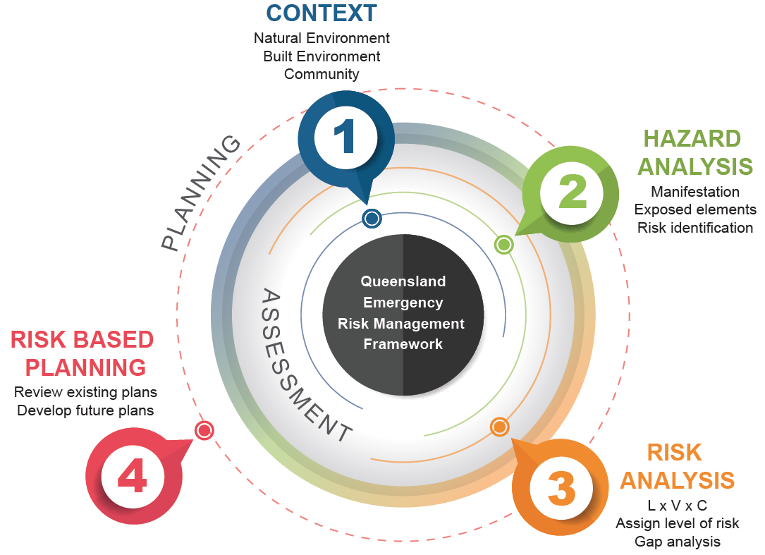
The Approach to Assessing Hazard Related Risk and Risk Based Planning
Notes:
After reviewing international best practice an enhanced risk methodology (proof of concept) was trialled at the Disaster District level and subsequently endorsed by Queensland Disaster Management Committee (QDMC) on the 25th November 2016.

Slide 6
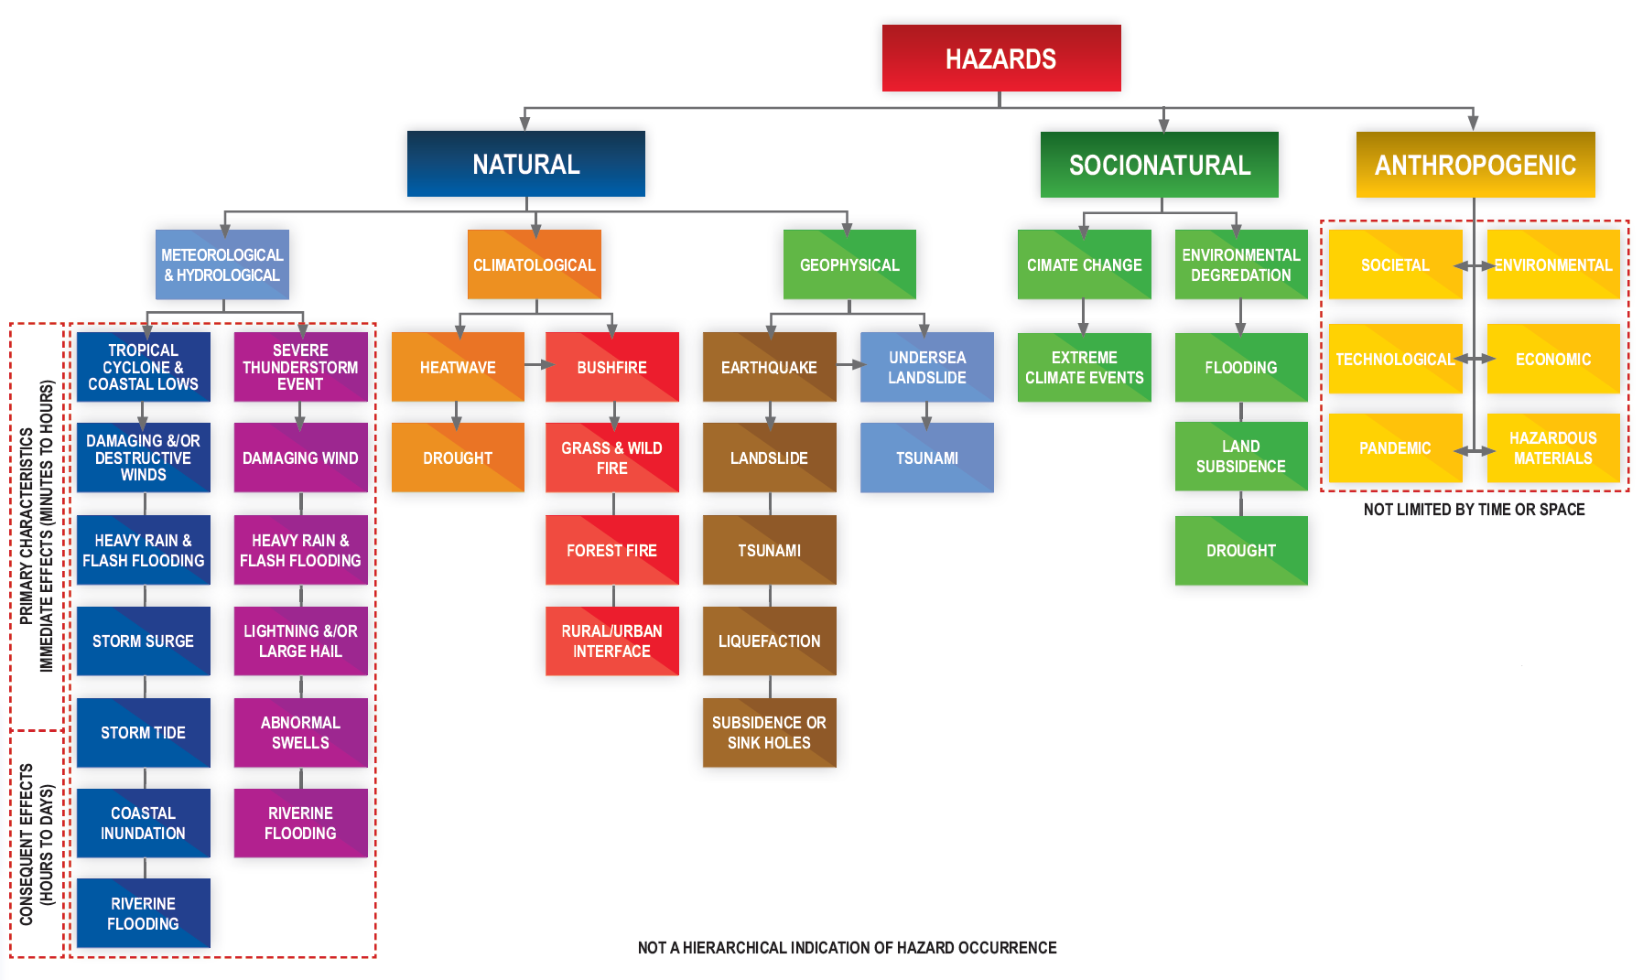
Understanding Hazards through Events and Their Characteristics

Slide 7
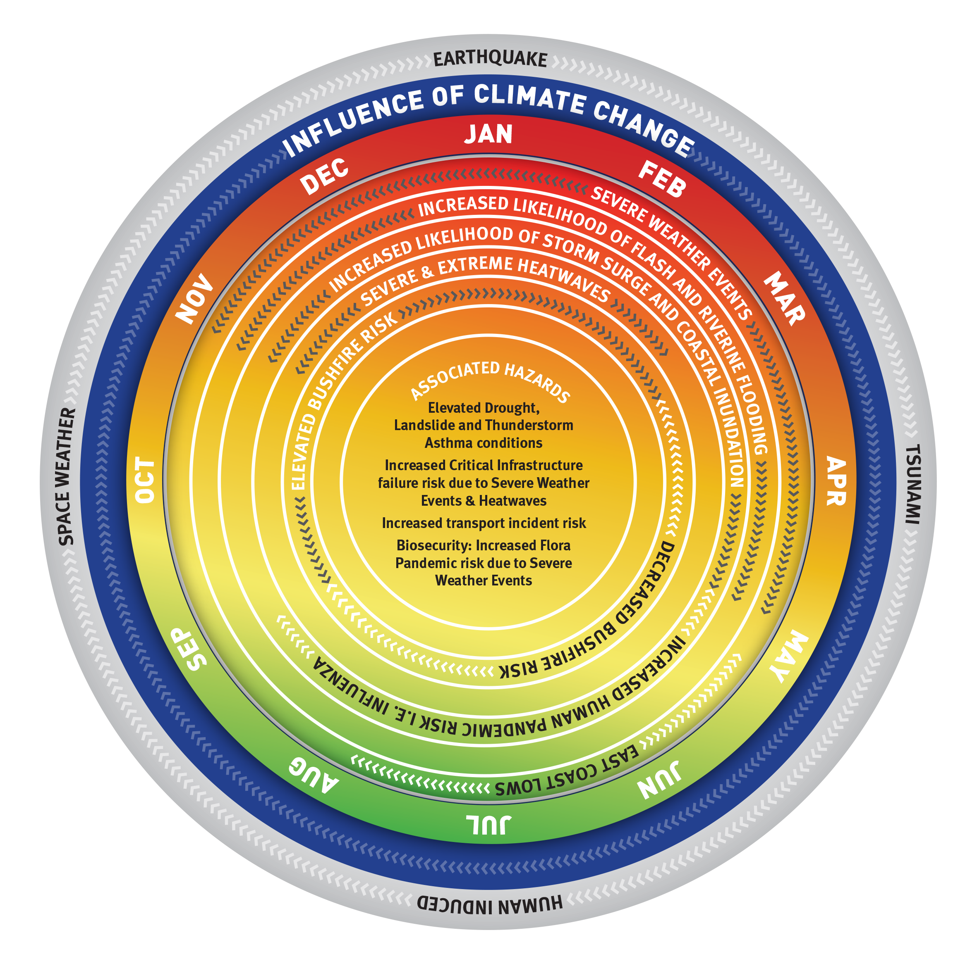
Understanding Hazards as an Annual Cycle
The identification of current and future hazards to be assessed via the QERMF is based on lead agency research and information.
Through a continual review process, QFES seeks to ensure that Local and District disaster management groups, and State agencies have the best information at hand when assessing hazard risk pertinent to their area of responsibility.
This diagram seeks to indicatively demonstrate those hazards which may impact Queensland on an annualised basis, whilst conveying the affect of climate change on these hazards (blue ring).
The annual “higher risk period” is highlighted by the orange to red areas, whilst the “lower risk period” is highlighted by the green area.
The grey ring highlights those “outlier hazards” that may manifest at any time but which have a very low probability of occurrence annually.

Slide 8
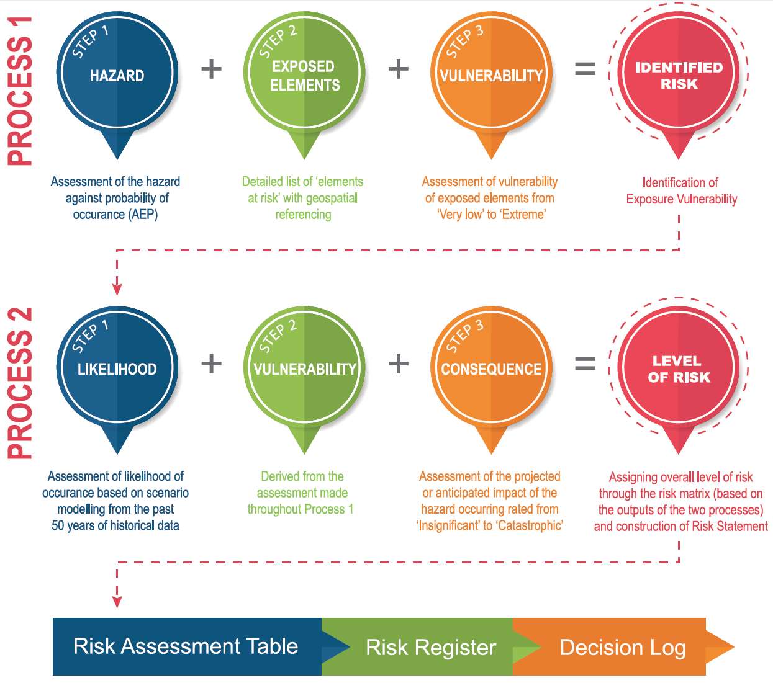
Robust locally led risk assessments ensuring ‘fit-for-purpose’ planning enabling risk assessors to articulate and define:
Vulnerabilities of systems, structures, processes;
Capability and capacity versus capacity gaps;
Dependencies/interdependencies; and
Consequences including those cascading and cumulative effects.

Slide 9
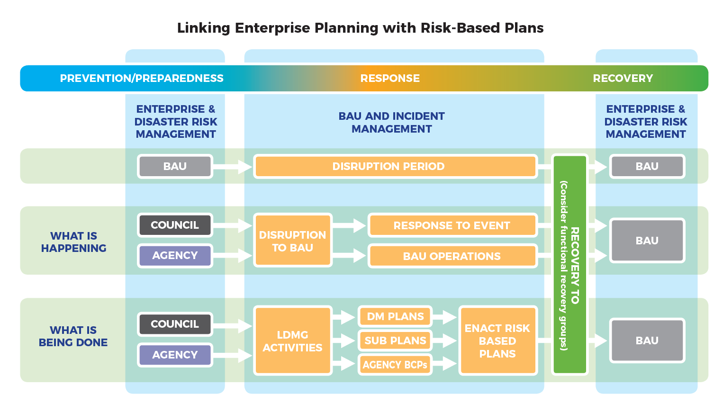

Slide 10
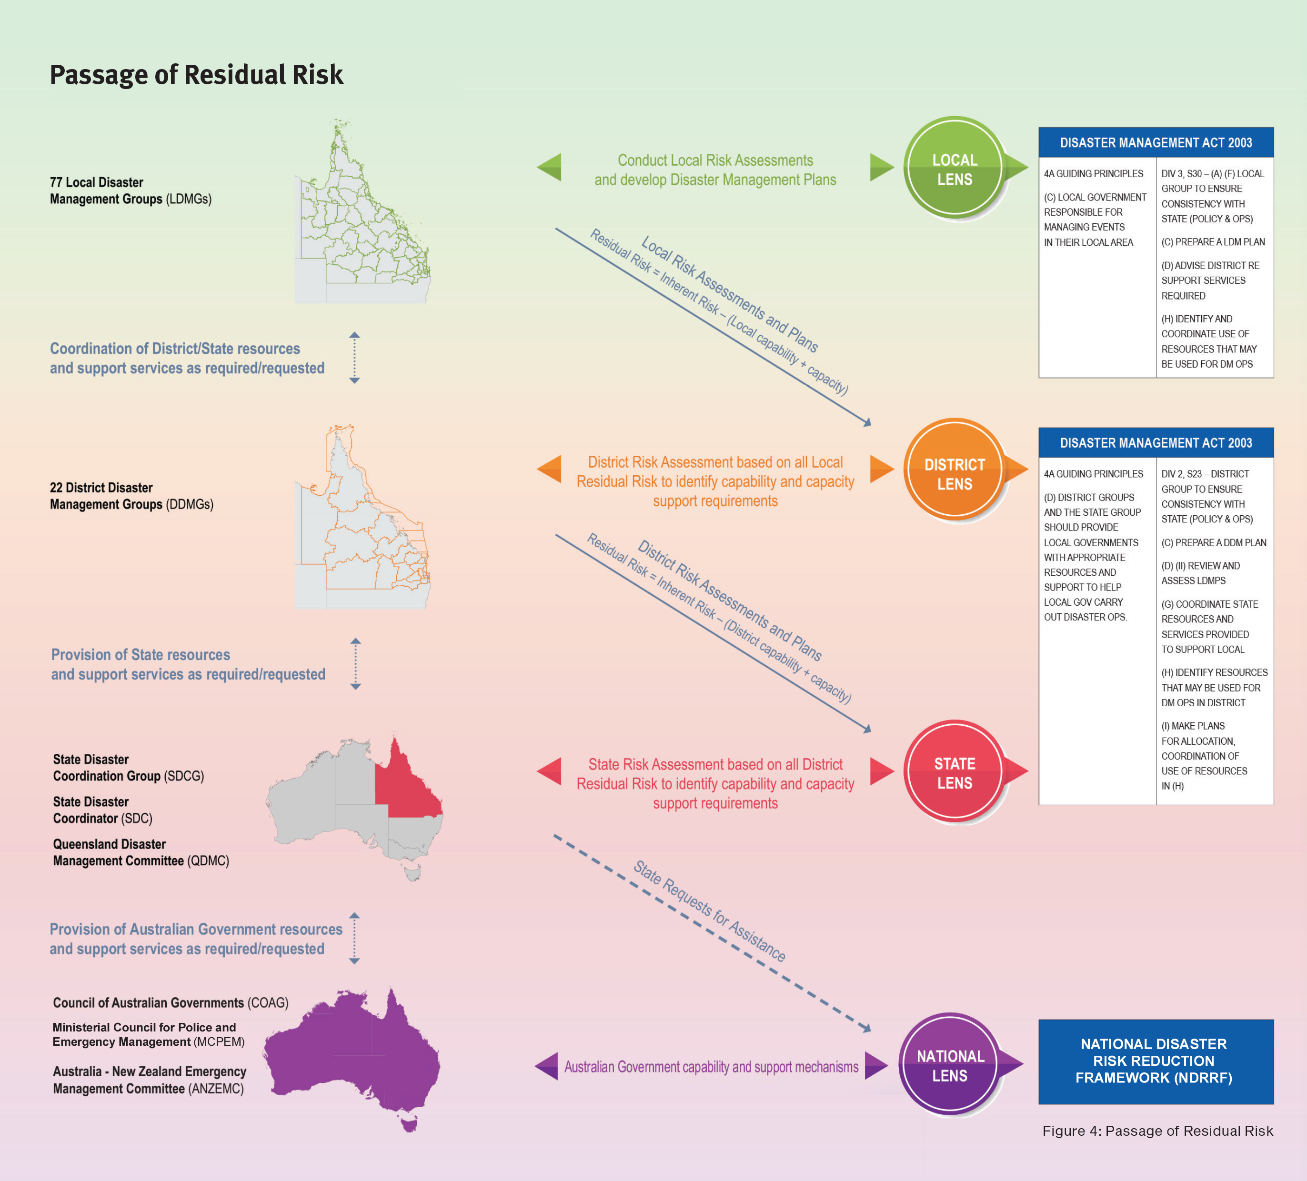
Passage of ‘Residual Risk’

Slide 11
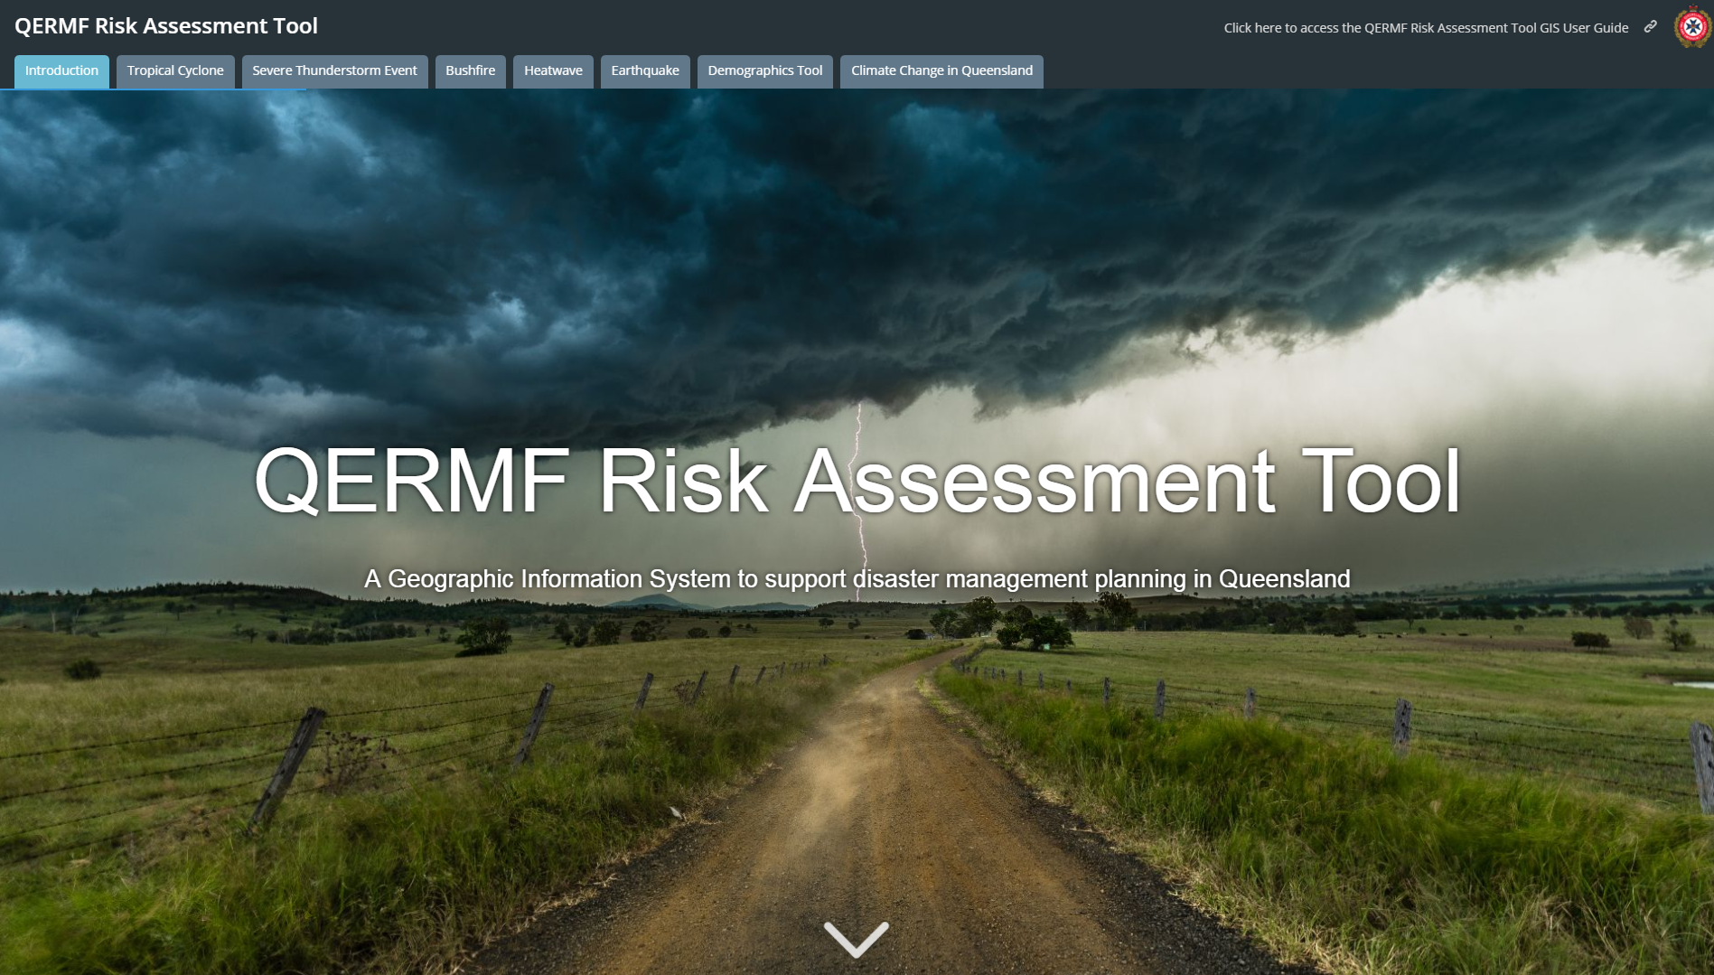
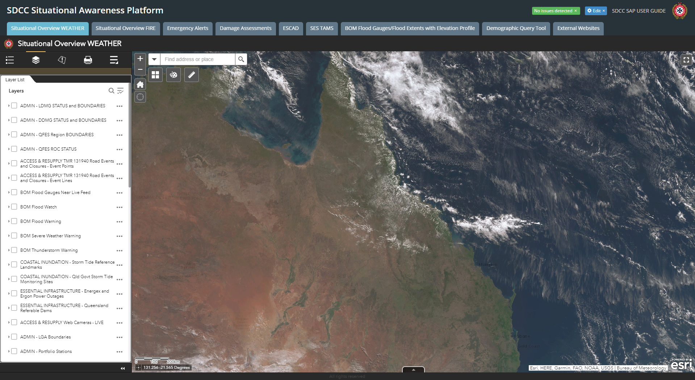
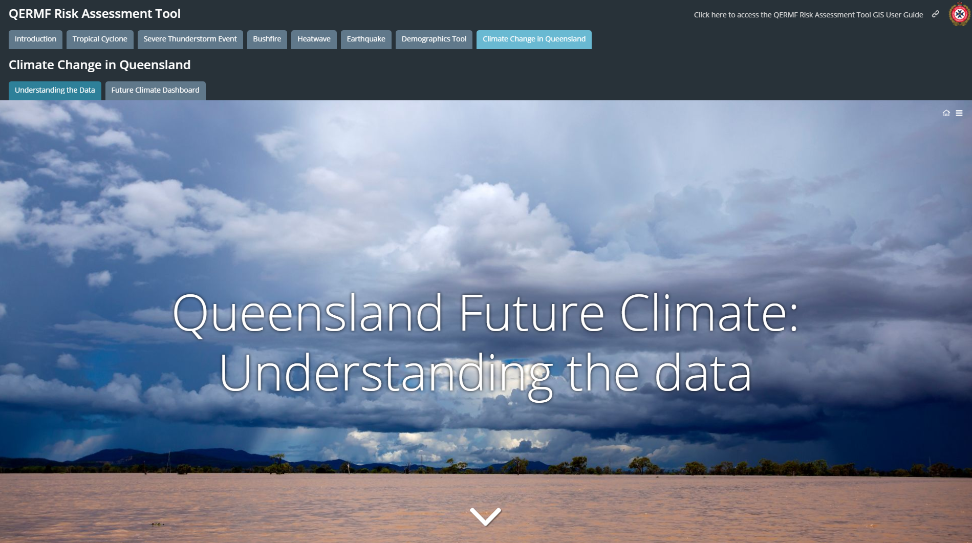
Use of Geospatial Intelligence and Data Sharing

Slide 12
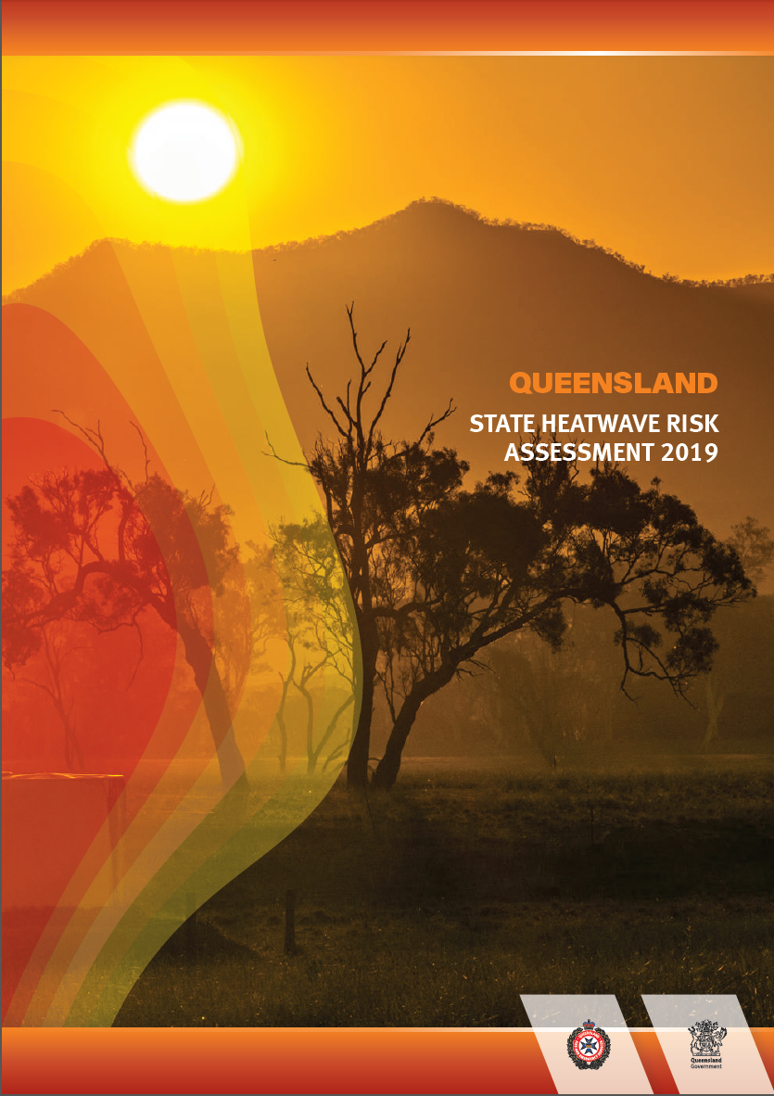
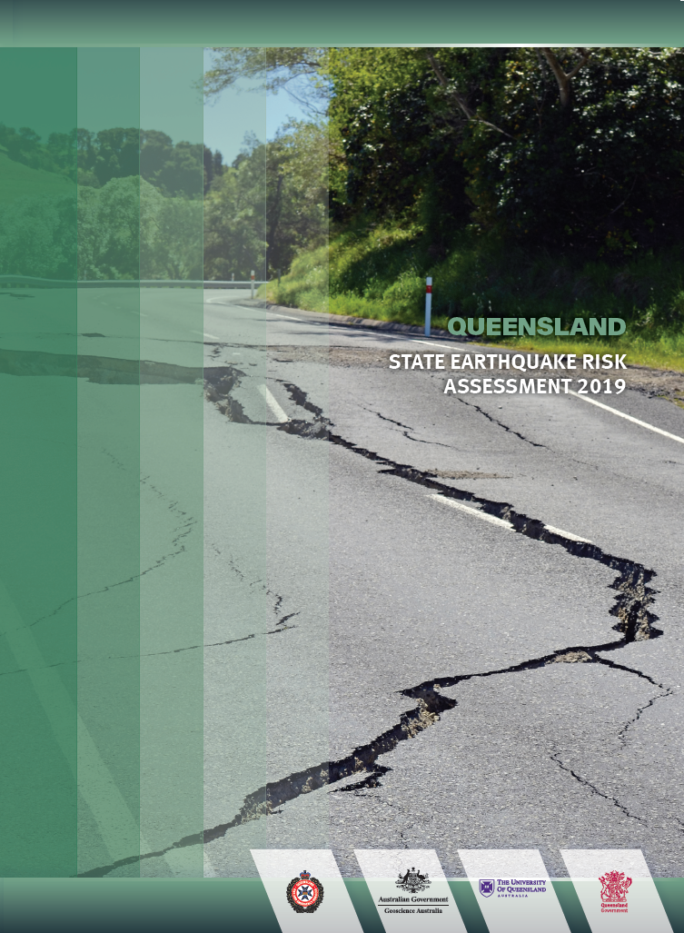
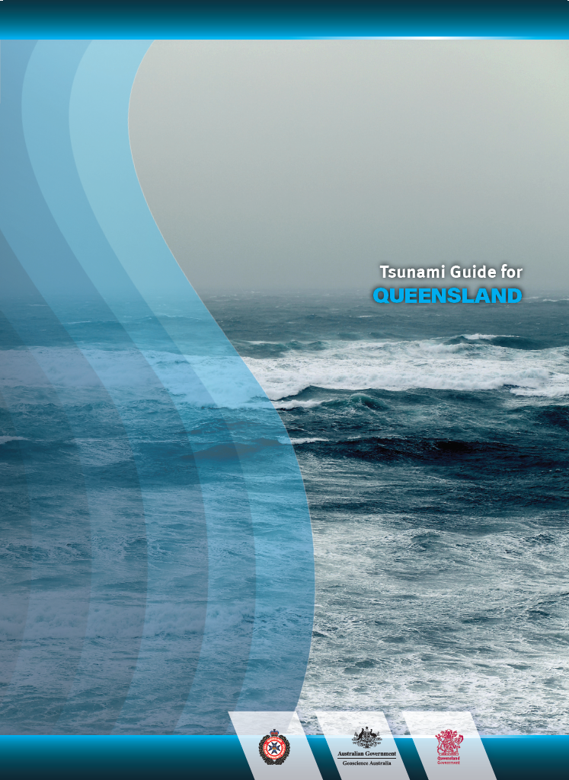
State Based Assessments – Supporting Disaster Management Planning

Slide 13
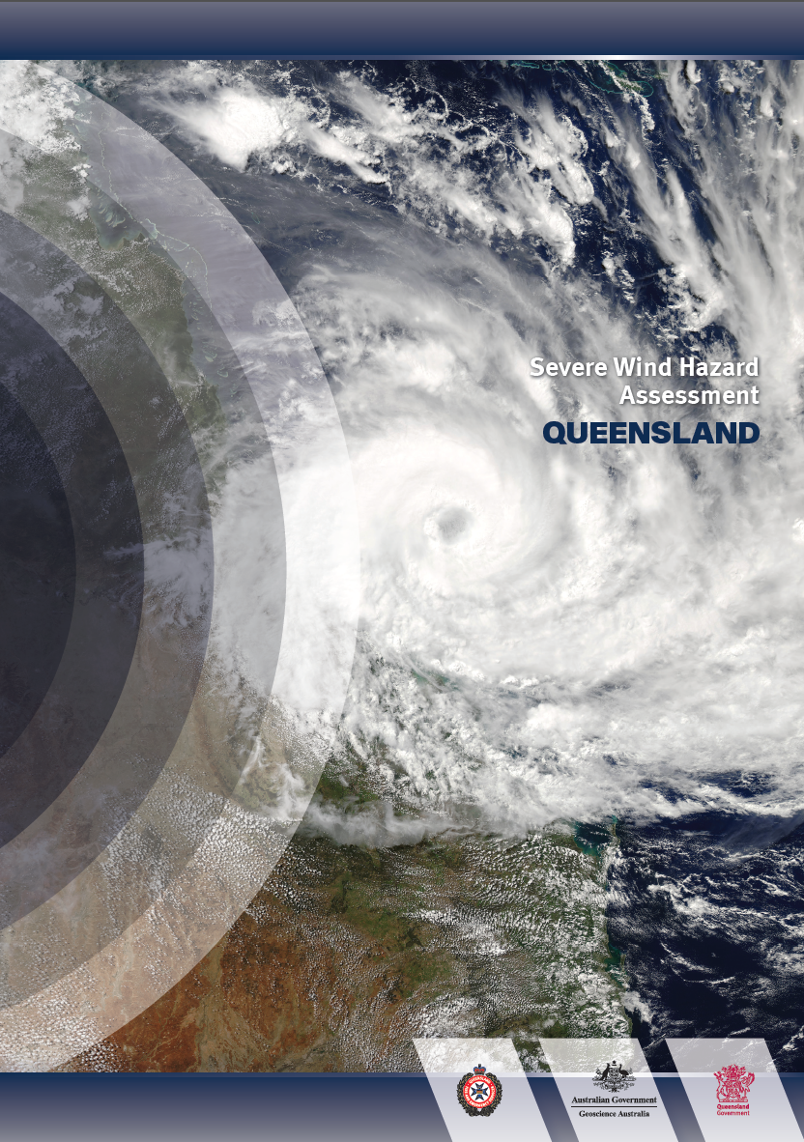
Severe Wind Hazard Assessment - Queensland
The SWHA(Q) is a multi-agency project being led by Queensland Fire and Emergency Services in partnership with Geoscience Australia under terms of the Collaborative Heads Agreement (CHA) signed in January 2018.
Replicates a project undertaken by DFES in WA.
This project will complete in June 2020 and will deliver detailed vulnerability profiles from severe cyclonic winds against the communities and their infrastructure of Cairns, Townsville, Mackay, Gladstone, and the City of Gold Coast.
Will include the development of in house QFES capability to conduct operational severe wind hazard analysis and assessment.
Note: SWHA(Q) will provide the change in likelihood within the brackets of TS-TL, Cat 1-2, and Cat 3-5 for all Local Governments across four time horizons of 2030, 2050, 2070, and 2090.
Will link to the Severe Thunderstorm Risk Assessment: Current and Future Climate (2019 – 2022).

Slide 14
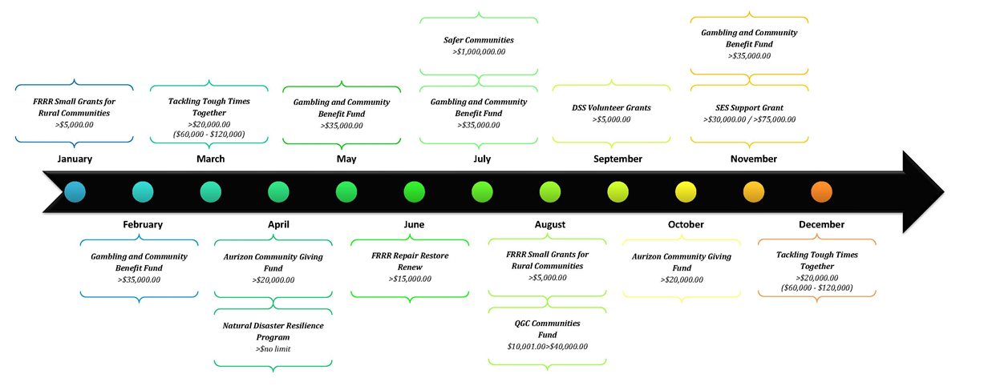
QERMF and Mitigation/Resilience Funding
LDMGs established under the Disaster Management Act.
eligible in own right to apply to some grant programs (e.g. Gambling Community Benefit Fund).
Risk mitigation projects and planning for the entire community.
Unique opportunity to apply for projects as a collective group.
joint responsibility + big community reach = higher priority/score
high score + natural disaster = bank cheque (just kidding, but it will significantly increase your chances)
Previous risk mitigation projects:
Community engagement materials (& trailer)
Loading areas (Cape York annual flooding)
Solar energy containers/pods
Workshops/events
Notes:
Attended South Burnett LDMG workshop last year (mind blown)
Started working with Brenton, Matt and Adam to help promote grant opportunities to LDMGs and provide support
Wholistic overview to recognise significant risks to community
Any contribution to part-fund a project will also bump up your chances

Slide 15
Key Outputs of the QERMF
QERMF Programs of Work
Local Government and Disaster District Risk Assessments and Disaster Management Plans
Severe Wind Hazard Assessment for Queensland (September 2020)
Development of the QERMF Risk Information Portal – Q-RIP – (FY19/20)
Development of State Risk Assessment based on vulnerabilities identified at a Local, District & State level (June 2020)
Management of State level residual risk identified during and transmitted through completed Local and District assessments to the State Disaster Coordination Group (SDCG).
What does this mean for you?
Informed development of fit for purpose Disaster Management and Business Continuity Plans;
Enhanced collaboration between a collective of councils based on similar hazard profiles, climatic and geographic disposition, and/or economic interest;
Avenues for local capability development;
Guidance and advice on funding streams that link to outputs of the assessment process; and/or
Guidance and advice on the effective management of disaster related risk.

Slide 16
Benefits of QERMF
Communicates consistent and scientifically-based understanding of the “all-hazards approach” leading to the conduct of appropriate risk assessments, development of pertinent plans and necessary resource expenditure.
Prioritisation of resources is based on local capability and capacity evaluated against identified risks. This assessment seeks to help inform:
Applications for funding towards mitigation strategies, betterment projects etc.; and/or
Appropriate resource reallocation and/or allocation of risk ownership/responsibility.
Risk governance is improved through transparency and accountability in the acceptance, mitigation and/or transfer of residual risk through Queensland's disaster management arrangements (QDMA).
Disaster management networks will be strengthened and better aligned. Stakeholders will have improved confidence in State level coordination, guidance and support across all levels of QDMA.
Risk assessments seek to inform policy standards and objectives as outlined within the SPP, EMAF and QSDR in line with Local, Regional and State priorities.

Slide 17
Questions?

